Slide 1
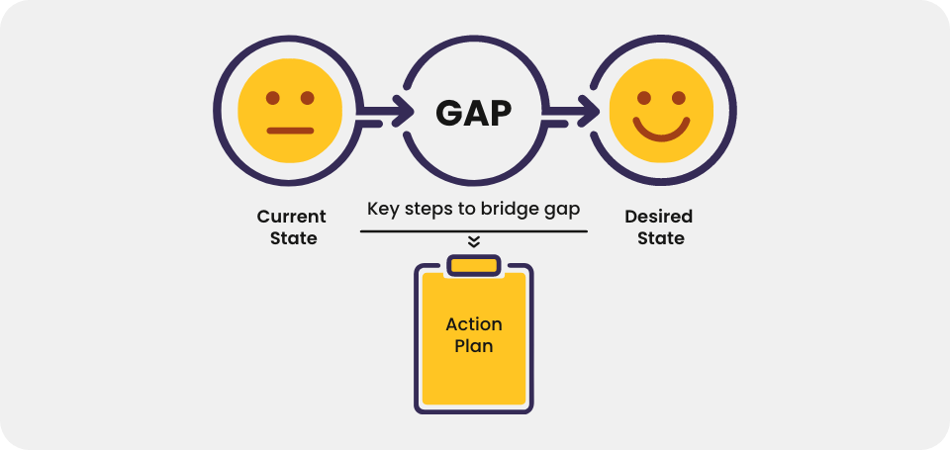
Identify pain points
Identify desire state
Bridge the gap
Customer pain points
Pain point
process
Financial
Productivity
support

Slide 2

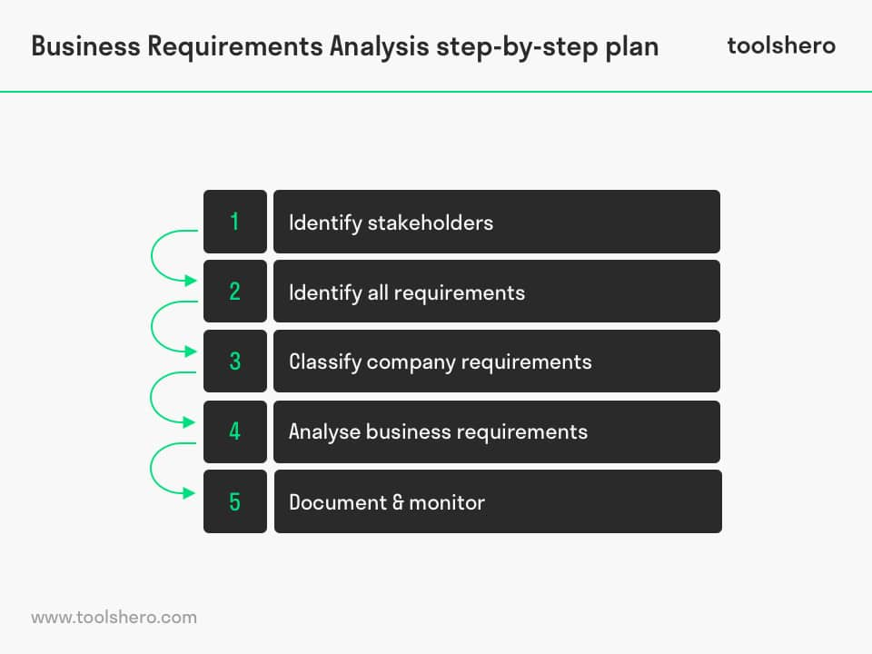
Requirement gathering and analysis

Slide 3

Steps to solution
Provide generic solution
Provide solution comparison
Select the best one according to customer requirements
How the solution fill the gap
Know working components, solution workflow and the how
know product line. pov should be technical mapping with price
advance licensing knowledge

Slide 4
Choose the best
Be technology centric
Analysis and document all possible solution
Integrate cause and effect domain
Define all affected entity
Define problem at pin point

Slide 5
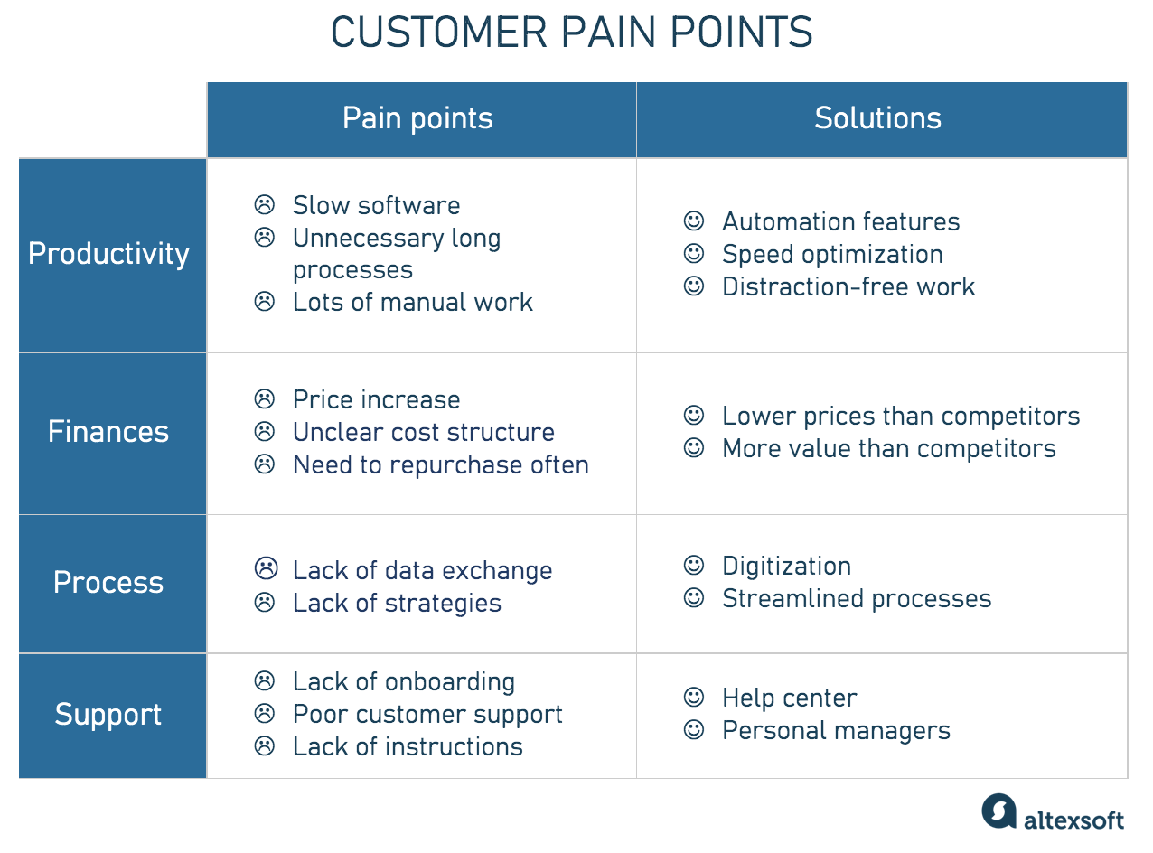

Slide 6
Provide solution comparison
Value-based pricing
Scalability
Agility
Stability
Degree of compliance with customer requirements
Degree of compliance with industry standard
Global research rating
Integration capability
Security operation capability
Manageability
Operating expenses
Support
Select the best one

